Slide 1

Python OOP - Part 2
OOP Principles, Solid Principles (Continue), Error Handling and File I/O
Program: EDGE-CSE CUET DIGITAL SKILLS TRAINING
Course: Python (Django) [Intermediate]
Lecture: Training Session-05 Date: 26th September, 2024 Duration: (2+2) hours
Instructor: Tanveer Rahman, Sr. Software Engineer, Friends Corp. Chuo-ku, Tokyo, JP shakil10vr@hotmail.com, 01626735005

Slide 2
Agenda
OOP Principles
SOLID Principles (Continue)
Error Handling
File I/O

Slide 3
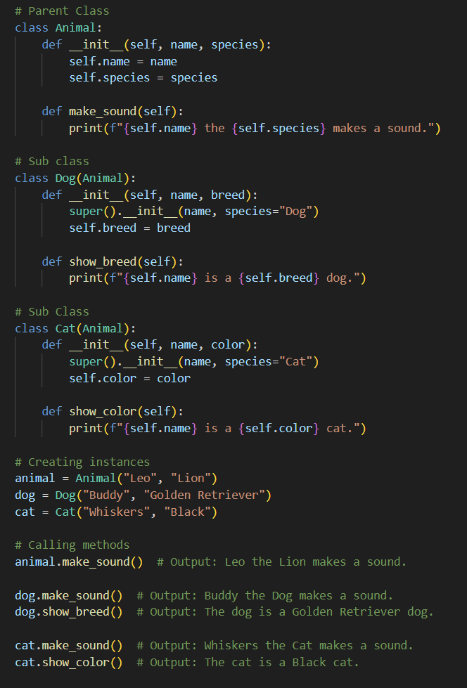
Inheritance
Reusability and Hierarchical Relationships
Inheritance allows a class (child) to inherit attributes and methods from another class (parent).
It promotes code reuse and logical hierarchy.
Child classes can extend or modify parent class behavior
Example:
Explanation:
The Animal class has a method make_sound().
The Dog and Cat classes inherit from Animal and they don’t have make_sound() method but they can use it with their own specific attributes.
Key Benefit:
Reusability of common behavior while allowing specialization.

Slide 4
Task 1
Task (Inheritance)(10 min):
Create a parent class Vehicle with attributes like model, year and wheels.
Inherit Car and Bike classes from Vehicle and add specific attributes like doors for Car and cornering_angle for Bike.
Test by creating instances of Car and Bike.

Slide 5
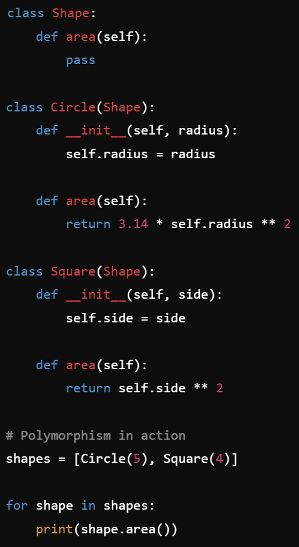
Polymorphism
Flexibility and Extensibility
Polymorphism allows objects of different types to be treated as objects of a common superclass.
The same method can behave differently depending on the object calling it.
This enhances flexibility and makes code extensible.
Example:
Explanation:
Both Circle and Square classes inherit from Shape and implement the area() method differently.
When looping through the shapes list, the correct area() method is called for each object.
Key Benefit:
Code can be extended without modifying the original structure.

Slide 6
Task 2
Task (Polymorphism)(10 min):
Create a Player base class with an abstract method play().
Inherit FootballPlayer and CricketPlayer classes, each implementing the play() method differently.
Create instances of both classes and call play() to demonstrate polymorphism.

Slide 7
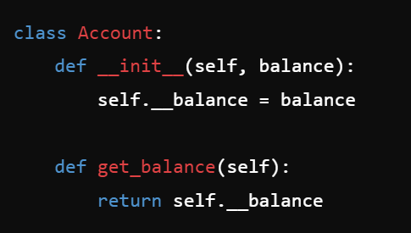
Encapsulation
Hides the internal state of an object and only exposes necessary methods.
Achieved using private and public members.

Slide 8
Task 3
Task (Encapsulation)(10 min):
Create a Player base class with an abstract method play().
Inherit FootballPlayer and CricketPlayer classes, each implementing the play() method differently.
Create instances of both classes and call play() to demonstrate polymorphism.

Slide 9
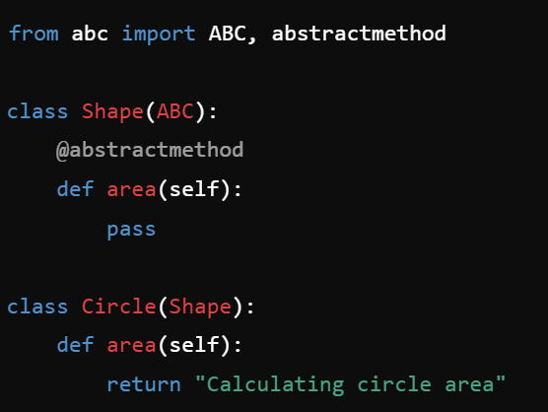
Abstraction
Simplifies complex reality by modeling classes based on essential features.
Achieved through abstract classes and interfaces.

Slide 10
Task 4
Task (Abstraction)(10 min):
Create an abstract class Shape with an abstract method area().
Implement subclasses Circle and Rectangle, each with its own area() method.

Slide 11
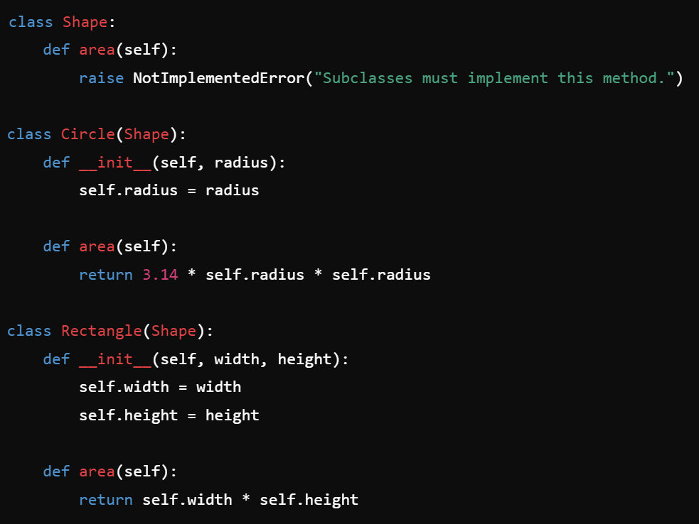
Task 5
Task (Practical Example of Open/Closed Principle (OCP)) (10 min):
Create a base class Shape with a method area().
Implement derived classes Circle and Rectangle that extend Shape and implement the area() method.
Show how to add a new shape Square without modifying existing code.
Code Skeleton:

Slide 12
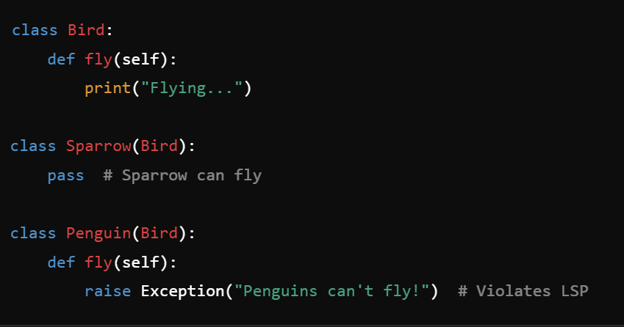
Task 6
Task (Practical Example of Liskov Substitution Principle (LSP)) (10 min):
Create a class Bird with a method fly().
Implement subclasses Sparrow (inherits Bird) and Penguin (also inherits Bird).
Show how Penguin breaks LSP and discuss a better design.
Code Skeleton:

Slide 13
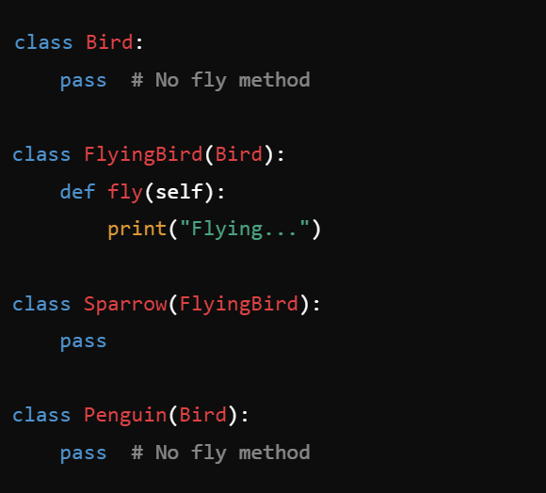
Task 6 Solution
Task (Practical Example of Liskov Substitution Principle (LSP)):
Create a class Bird with a method fly().
Implement subclasses Sparrow (inherits Bird) and Penguin (also inherits Bird).
Show how Penguin breaks LSP and discuss a better design.
Better Design:

Slide 14
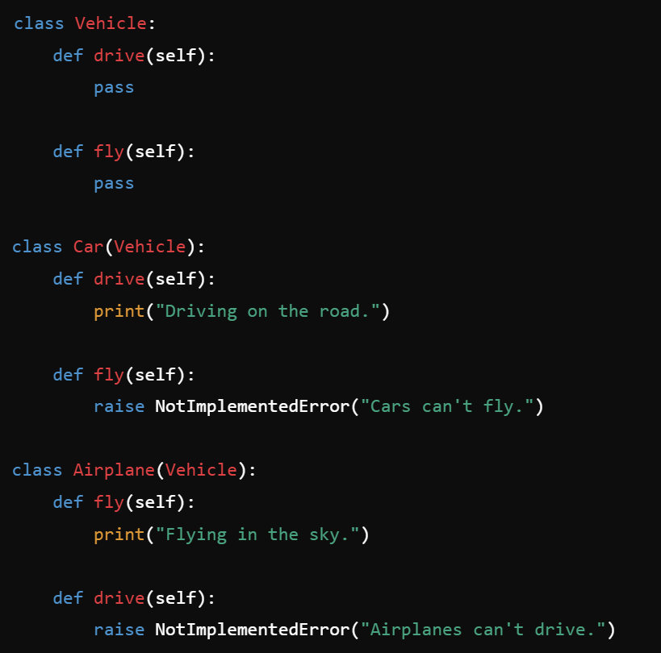
Task 7
Task (Practical Example of Interface Segregation Principle (ISP)) (10 min):
Create an interface Vehicle with methods drive() and fly().
Implement classes Car (implements drive()) and Airplane (implements fly()).
Show how to refactor to separate interfaces.
Code Skeleton:

Slide 15
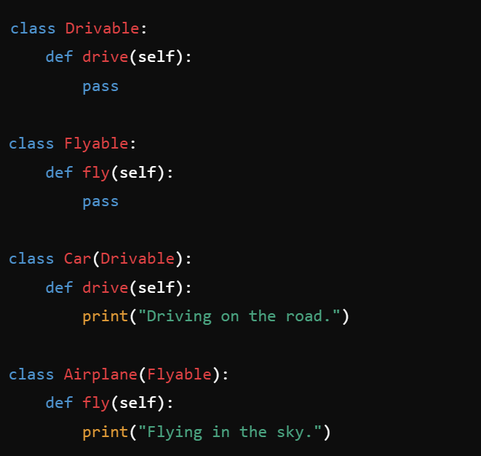
Task 7 SOLUTION
Task (Practical Example of Interface Segregation Principle (ISP)) (10 min):
Create an interface Vehicle with methods drive() and fly().
Implement classes Car (implements drive()) and Airplane (implements fly()).
Show how to refactor to separate interfaces.
Refactored Interfaces:

Slide 16
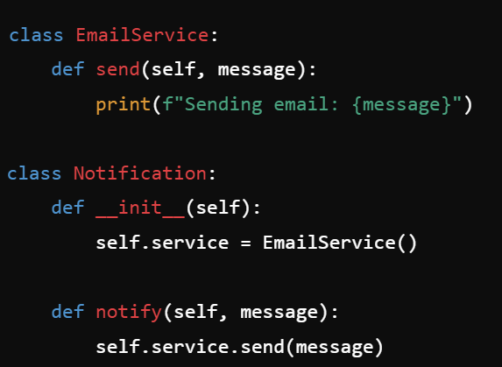
Task 8
Task (Practical Example of Dependency Inversion Principle (DIP)) (10 min):
Create a Notification class that uses a hardcoded EmailService.
Refactor to use an interface for notification services.
Code Skeleton:

Slide 17
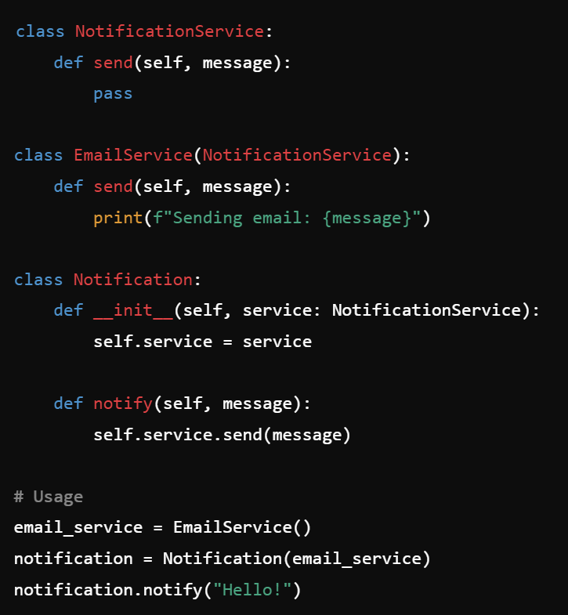
Task 8 Solution
Task (Practical Example of Dependency Inversion Principle (DIP)) (10 min):
Create a Notification class that uses a hardcoded EmailService.
Refactor to use an interface for notification services.
Refactored Code:

Slide 18
Error Handling
Definition:
Mechanism for responding to errors in code execution using try, except, finally.
Key Benefits:
Managing Exceptions properly.
Example:
try: num = int(input("Enter a number: ")) print(10 / num) except ZeroDivisionError: print("Cannot divide by zero.") except ValueError: print("Invalid input.")
Ensure that program never crushes. Diverting logic to other ways if usual logic fails.

Slide 19
Task 9
Task (Error Handling) (10 min):
Write a program that prompts the user to input two numbers and divides the first by the second.
Use exception handling to catch division by zero and invalid input errors.

Slide 20
File Operations
Features
Reading Files: open('file.txt', 'r') Writing Files: open('file.txt', 'w') Managing Files: Checking if the file exists, handling file operations using with statements..
Example:
with open('example.txt', 'w') as file: file.write('Hello, World!’) with open('example.txt', 'r') as file: print(file.read())

Slide 21
Task - 10
Task (File I/O) (20 mins):
Write a program that writes user input into it a file.
Then, read the content of the file and print it to the console.
If the file doesn’t exist and FileNotFoundError exception occurs, create the file, and execute 1st and 2nd instruction.
Use Class and Objects for performing above operations

Slide 22
ReCAP
OOP principles: Inheritance, Polymorphism, Encapsulation, Abstraction.
Solid principles extended
Error handling and file operations.

Slide 23

Q&A Session

